Slide 1


Slide 2

Sysinternals – The Hidden Gems

Slide 3
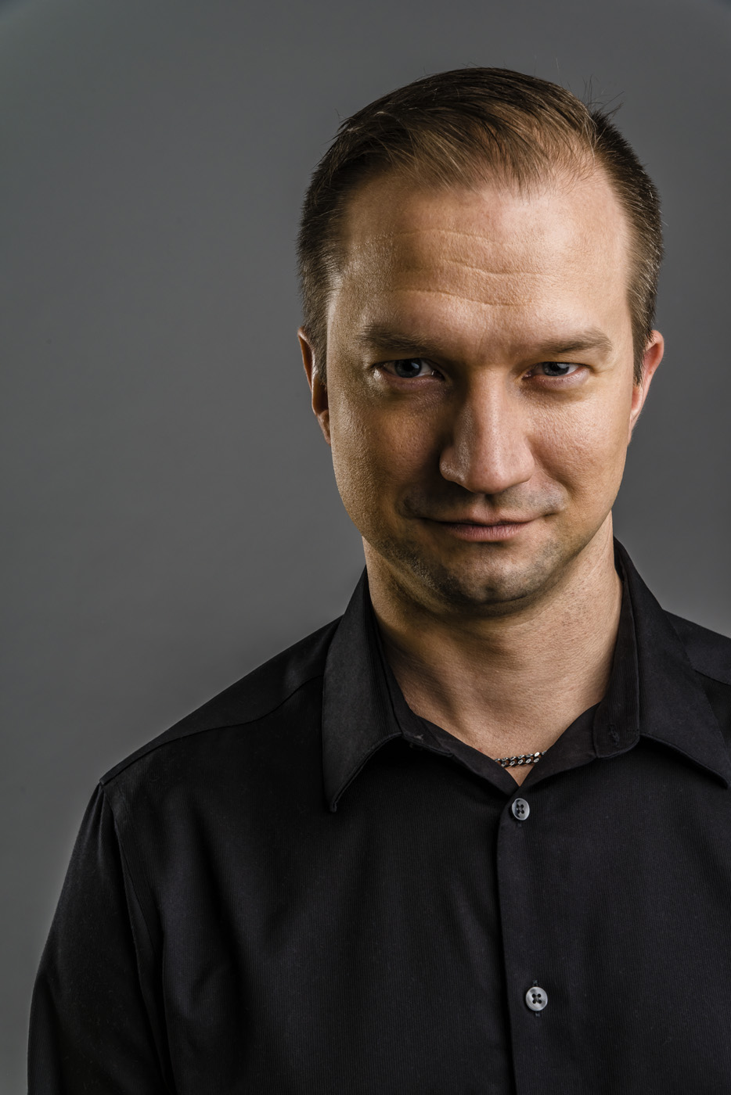
Sami Laiho Senior Technical Fellow adminize.com
IT Admin since 1996
MCT since 2001
MVP in Windows OS since 2011
Specializes in and trains:
Troubleshooting
Windows Internals
Security, Social Engineering, Auditing
Centralized Management, Active Directory
Trophies:
Ignite 2018 – Session #1 and #2 (out of 1708)
Best External Speaker at Ignite 2017
Best Sessions (#1 and #2) at TechTalks 2017, Helsinki
Best Session at AppManagEvent 2017, 2018, Utrecht
TechDays Sweden 2016, 2018 – Best Speaker
NIC 2016, 2017 - Best Speaker
Ignite 2015 – Best male presenter ;) (#2 out of 1000 speakers)
TechEd Europe and North America 2014 - Best session, Best speaker
TechEd Australia 2013 - Best session, Best speaker
TechEd Europe 2013 - Best Session by an external speaker

Slide 4

This session is not about
Process Explorer
Process Monitor
Sysmon
AI

Slide 5
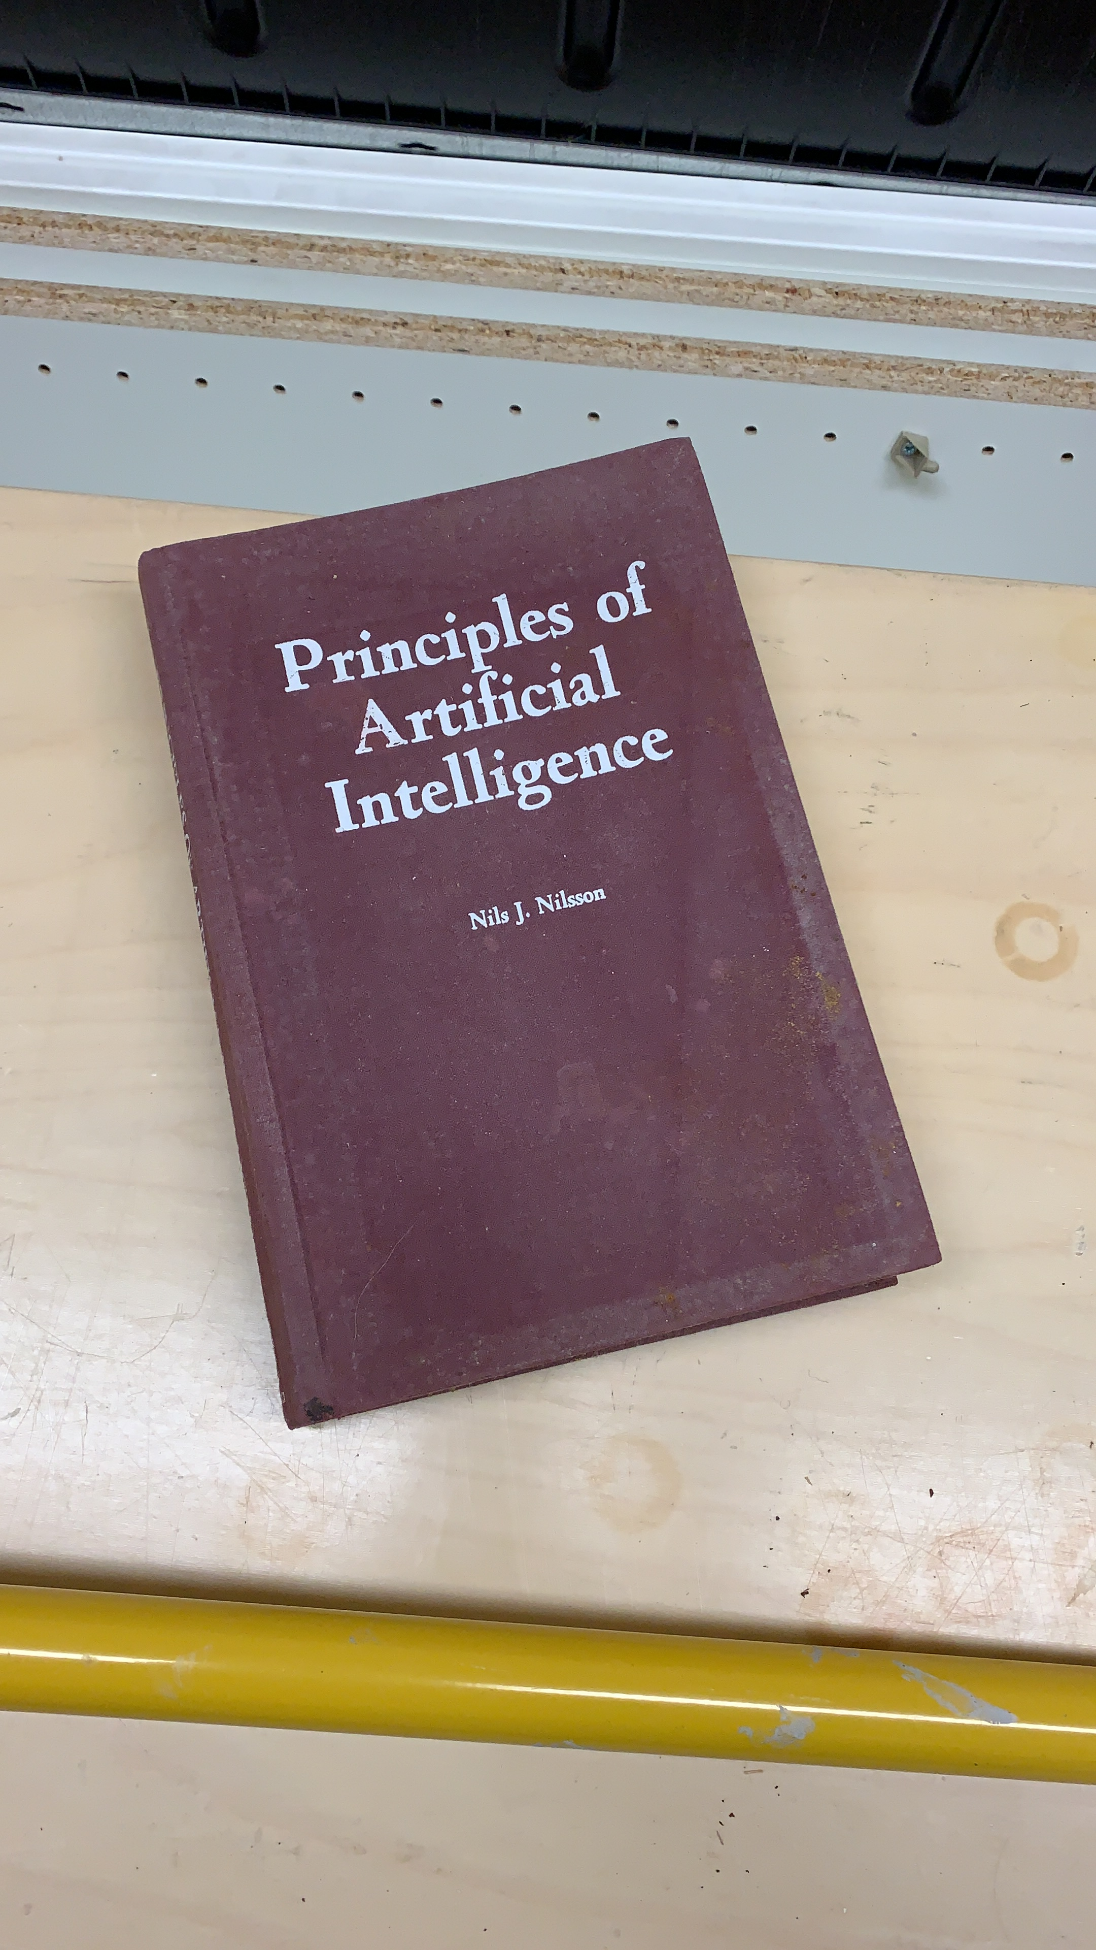
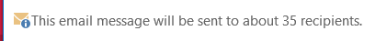

Slide 6
Zoomit

Slide 7
procdump

Slide 8
autoruns

Slide 9
strings

Slide 10
vmmap

Slide 11
rammap

Slide 12
testlimit

Slide 13
Pendmoves and movefile

Slide 14
Accesschk, accessenum, shareenum

Slide 15
sysmon

Slide 16
livekd

Slide 17
pstools

Slide 18
clockres

Slide 19
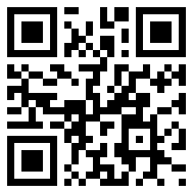
Contact
sami@adminize.com
Twitter: @samilaiho
Blog: http://blog.win-fu.com/
Free newsletter: http://eepurl.com/F-GOj
My trainings:
https://win-fu.com/ilt/
https://win-fu.com/dojo/
Free for one month!! Code:”Trial2018”
Need a PluralSight code?
Send an email to me!

Slide 20
Slides and demos from the conference will be available at
https://github.com/nordicinfrastructureconference/2019

